Slide 1
Data-Driven Optimization for B2B HVAC&R Operations
A Business Data Management Capstone Project
Yash Mishra | 21f1006461

Slide 2

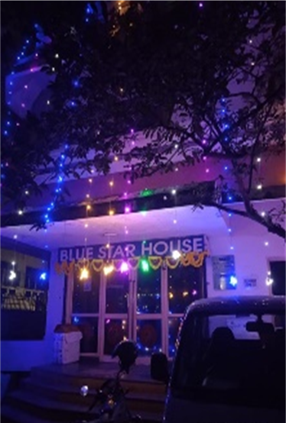
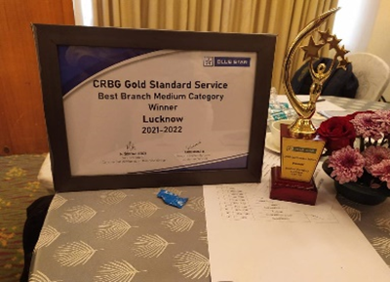
Blue Star
Foremost HVAC&R industry in India
₹12 crores revenue at Uttar Pradesh branch in 2022-23
Leveraging SAP Point of Sale (PoS) for data collection
Led by Mr. Upadhyay to improve decision-making and cultivate a culture of efficiency
Transformative project initiated for data-driven decision-making
Focus on enhancing data literacy and showcasing analysis strategies
Aims to foster adaptability, efficiency, and strategic growth
Mr. Pravesh Upadhyay Area Manager Uttar Pradesh Branch Office Blue Star
Best Branch Winner 2021-22
The Office

Slide 3
expectations
assess
Assess retailer performance to enhance strategic effectiveness.
interplay
Navigating the intricate interplay of demand and supply dynamics
Exploration
Explore avenues for business growth and new opportunities.
Empowering
Empowering the team by enhancing data literacy and showcasing strategies for effective data analysis.

Slide 4
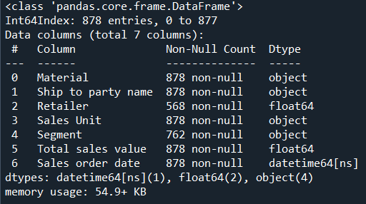
DATA
In total sixty-two columns were present in the sales data. After extensive discussions with Mr. Upadhyay we concluded to narrow down our approach to seven “+one” columns.
1. Retailer: The entity involved in the sale of HVAC&R products provided by Blue Star. A unique numeric code is allotted.
2. Sales Unit: A unit responsible for generating leads.
3. Segment: A classification system categorizing HVAC&R products based on specific criteria such as type, application, or target market.
4. Sales Order Date: The date on which the sales transaction was initiated or recorded.
5. Total Sales Value: The monetary value of the total sales transaction for HVAC&R products.
6. Material: The specific HVAC&R product model being sold by Blue Star.
7. Ship to Party Name: A unique identifier associated with the customer to which the HVAC&R products are shipped.
8. Number of Missing Values: Column-wise count of data points within the dataset where information is absent.

Slide 5
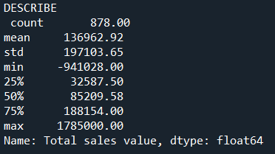
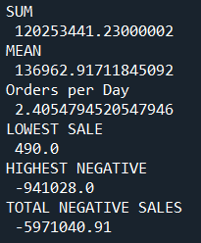
1. assess
High standard deviation.
Negative Values.
Few exceptionally high sales values.
Concentrated in the lower range.
Top Performer: “EA”, 90.33% of the total sales value.
“FT2” worst, only 1 lead.
Top Performer: Retailer “095”, 50% of the total sales volume, 49.33% to the overall revenue.
Lowest total sales volume of 19 orders by “082”.
Lowest financial contribution by “083” of ₹13,74,850.00.

Slide 6
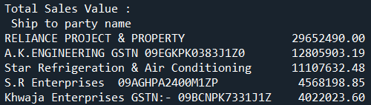
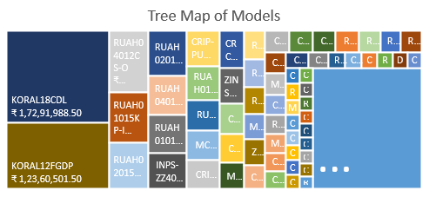
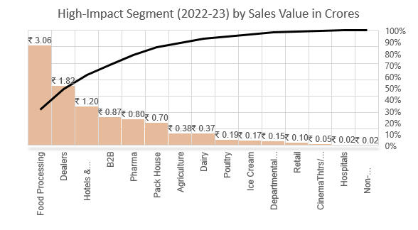
2. interplay
DOMINANCE
"Food Processing" and “Dealers", emerged as dominant contributors to the overall sales values. "Hotels & Restaurant“, “B2B" and “Pharma" contributed to 80% of sales.
PINNACLITY
Of total 245, the top-performing models were KORAL18CDL, KORAL12FGDP, RUAH04012CS-O, RUAH01015KP-I, RUAH02015KP-I and RUAH02012KP-O.
TRUST
RELIANCE PROJECT & PROPERTY, A.K. ENGINEERING, and Star Refrigeration & Air Conditioning collectively demonstrated their trust by contributing a total of ₹5.35 crores.

Slide 7
Exploration
TRENDS and
GROWING MARKET
Q1 2022: ₹3.87 Crores.
Q2 2022: ₹4.95 Crores sales spike.
Summer peaks in July 2022: ₹3.32 Crores total sales.
Q4 2022: ₹5.4 Lakhs
Q4 2023: ₹1.43 Crores surge, reflecting market demand.
Sales of Dairy, Pack House, Ice Cream and Poultry grew after the summer season contributing a total of ₹0.95 Crores indicative of new markets.

Slide 8
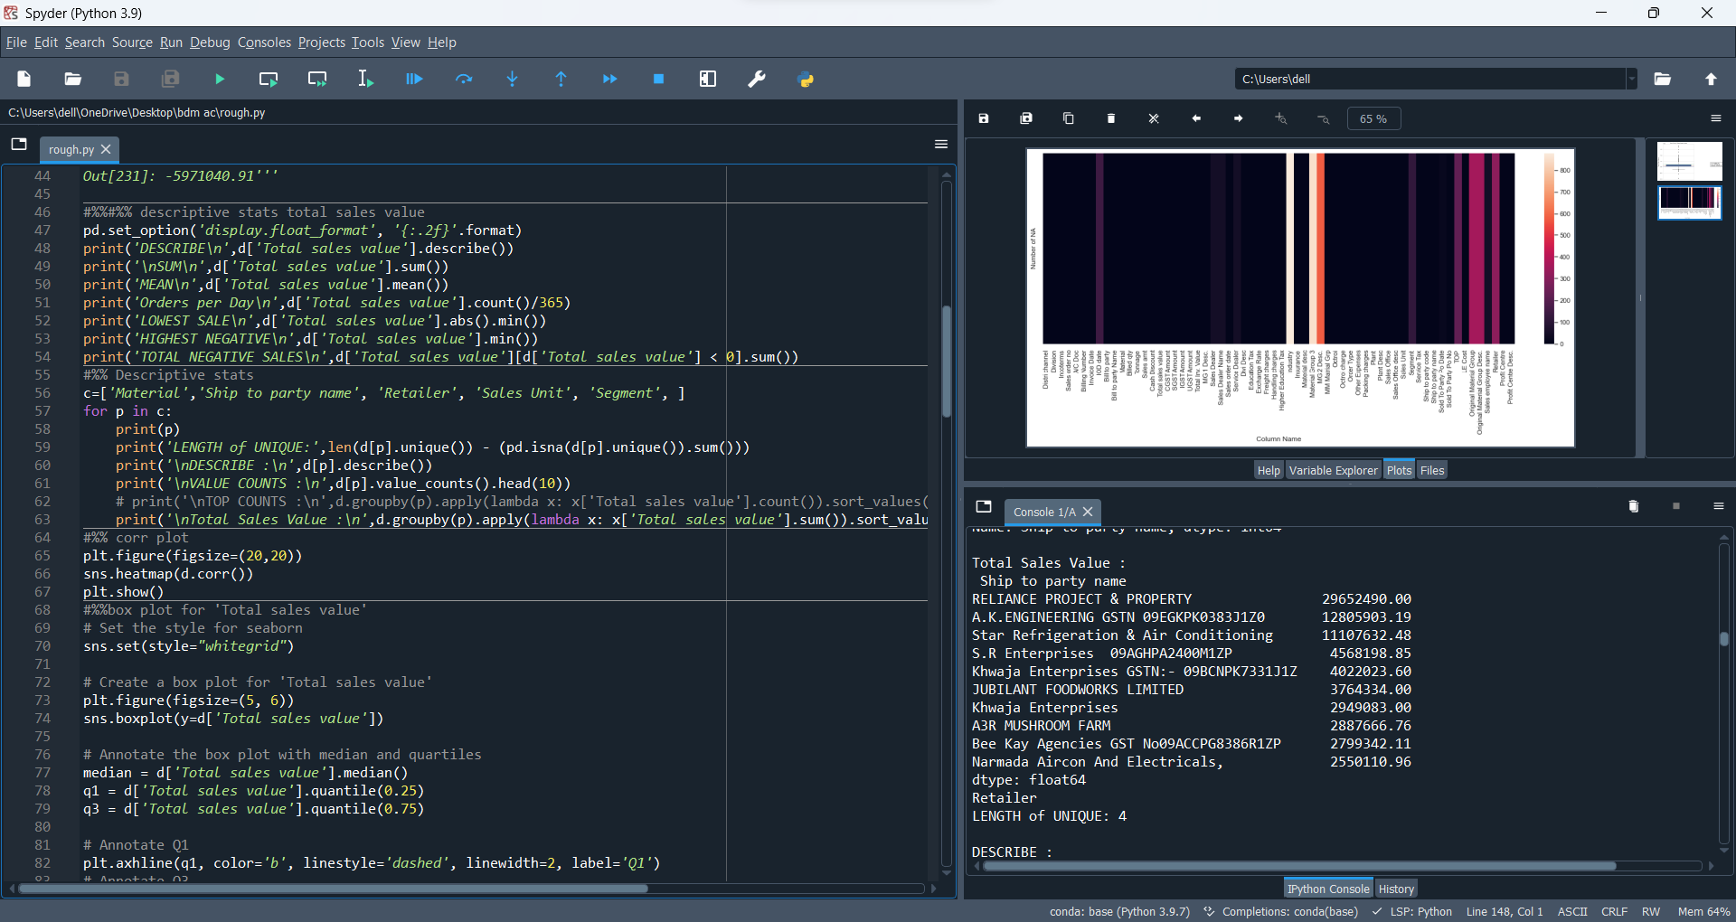
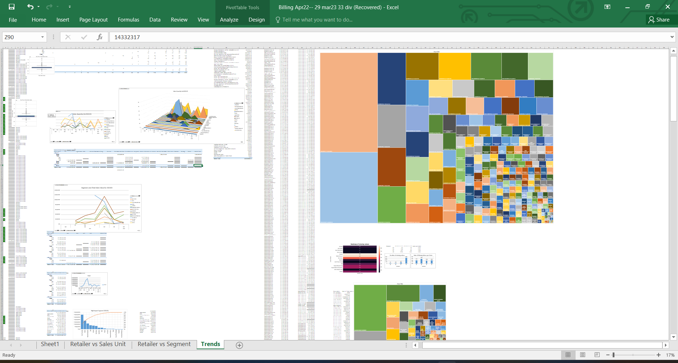
Empowering
Python and Excel were used to showcase the strengths of each tool for different aspects of the analysis.
Libraries such as numpy, pandas and seaborn and straightforward syntax made it accessible for initial analysis.
Excel was used particularly for specific subsets of the data for creating visually appealing reports as it is accessible to all stakeholders of the team.
A substantial problem of missing values, primarily attributed to data illiteracy.

Slide 9
Swot analysis
S
W
O
T
Effective Sales Unit ("EA")
Key Retailer Success ("095")
Dominant Segments ("Food Processing" and "Pharma")
Operational Challenges
Data Illiteracy
STRENGTH
WEAKNESS
OPPORTUNITY
THREAT
Replication of Successful Strategies
Tailored Strategies for Segments
Emerging Markets
High Variability in Total Sales
Seasonal Fluctuations
Data Quality and Recording

Slide 10
Thank You

